Slide 1

Houston, TX
2019
#XamDevSummit

Slide 2


Thinking outside of the box with Xamarin.Forms
Glenn Versweyveld
Depechie
Fixing your UI from the get-go

Slide 3


Slide 4
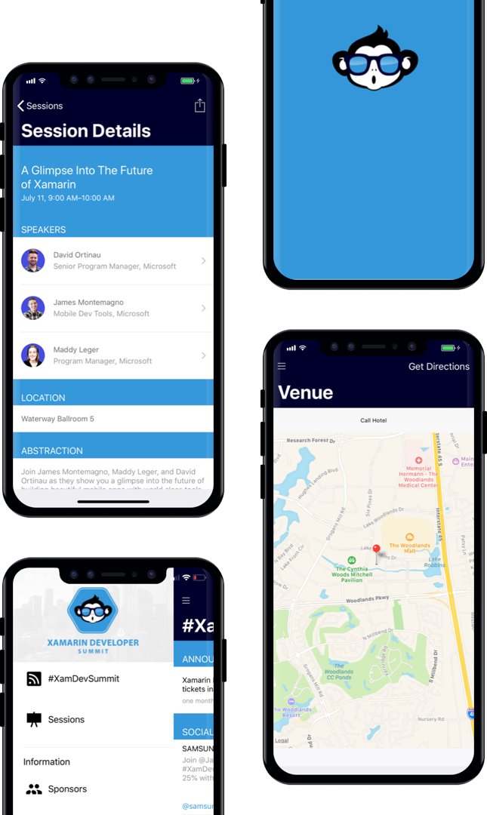
AGENDA
Download our Xamarin based mobile app: XamDevSummit.

Slide 5
Most common StackOverflow questions ( imho ) - Uniform title with extra content - Dynamic toolbar items - FabButton ( floating action button ) - Popups! Real world example by Steven Thewissen https://www.thewissen.io/create-a-kickass-banking-app-using-a-basepage-in-xamarin/

Slide 6
CODE

Slide 7
Q & A

Slide 8
Thank You!

